Slide 1





Smart CKD Predictor
Early Detection of Chronic Kidney Disease using Machine Learning with Risk-
Aware Intelligen
Team Leader - JAINIL DHOLARIYA
Team Member - GODHANI MITKUMAR
Team Member - HET THAKKAR
Team Member - RIDHAM SHAH
Team Member - VANSH SHAH
Mentor - ROHIT BHADAURIYA
College - LDRP INSTITUTE OF TECHNOLOGY
RESEARCH
Github : CKD Smart System

Slide 2

Project Objectives
Problem Statement
Project Overview – Introduction
End Users
Wow Factor in Project
Modelling/Block Diagram/Flow of Project
Result/outcomes
Conclusion
Future Perspective

Slide 3
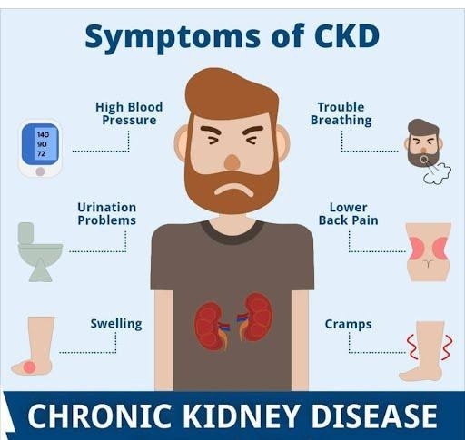


Problem Statement
Chronic Kidney Disease is a serious health problem in which the kidneys slowly stop working properly. The main issue is that CKD usually does not show clear symptoms in its early stages, so many patients find out about the disease only when it becomes severe.
In current healthcare practice, CKD detection largely depends on manual analysis of multiple laboratory and clinical parameters which is time consuming. Therefore, there is a need for an automated and intelligent prediction system that can analyze patient clinical and laboratory data collectively to enable early detection, risk assessment, and clinical decision support for Chronic Kidney Disease.

Slide 4
Project Overview - Introduction
This project presents a Machine Learning–based intelligent prediction system that analyzes clinical data, lifestyle factors, and risk-aware features to identify CKD at an early stage. Unlike traditional approaches that rely only on laboratory values, the proposed system provides risk-level prediction (Low / Medium / High) along with explainable insights.
The system is designed:
To develop an automated system for early CKD prediction.
To analyze patient clinical and laboratory data using machine learning.
To provide explainable predictions for better clinical trust.
To assist doctors in early screening and decision-making.

Slide 5
End Users
2)🏥Hospitals & Clinics
OPD screening tool
Lab-integrated prediction system
Benefit:
Manage the load of patient
High-risk patients priority
Standardized screening process
🧑‍⚕️Doctors (Primary Users)
OPD doctors
General physicians
Nephrologists
Benefit:
Fast risk assessment
Reason-based prediction
Better clinical decisions
3)🧑‍💼Healthcare Administrators / Govt Programs
Large-scale CKD screening (rural / urban)
Benefit:
Population-level kidney health monitoring
Early intervention programs
4)🎓 Students & Researchers
ML + Healthcare real-world project
Research & academic purpose

Slide 6
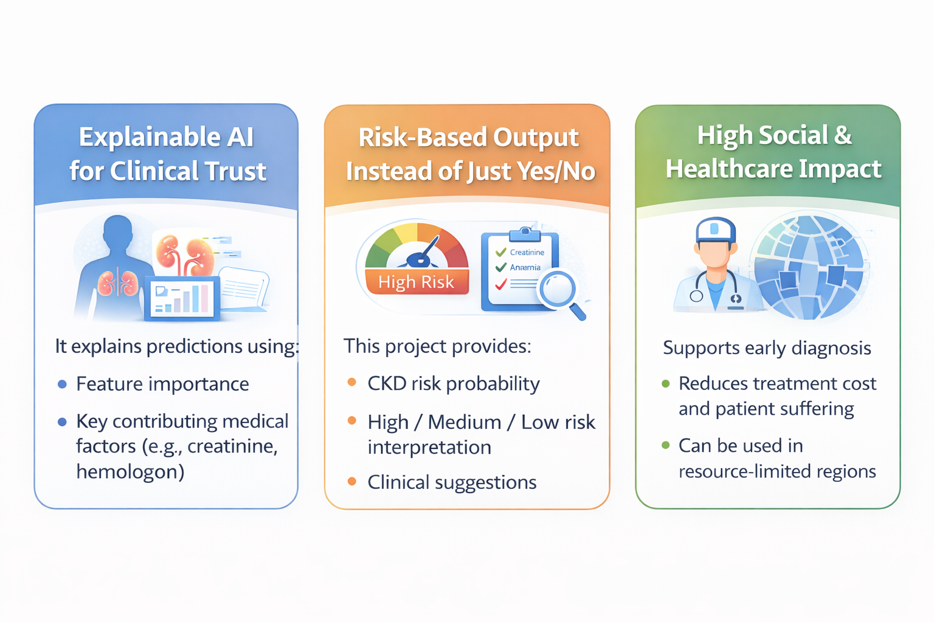
Wow Factors in Project

Slide 7
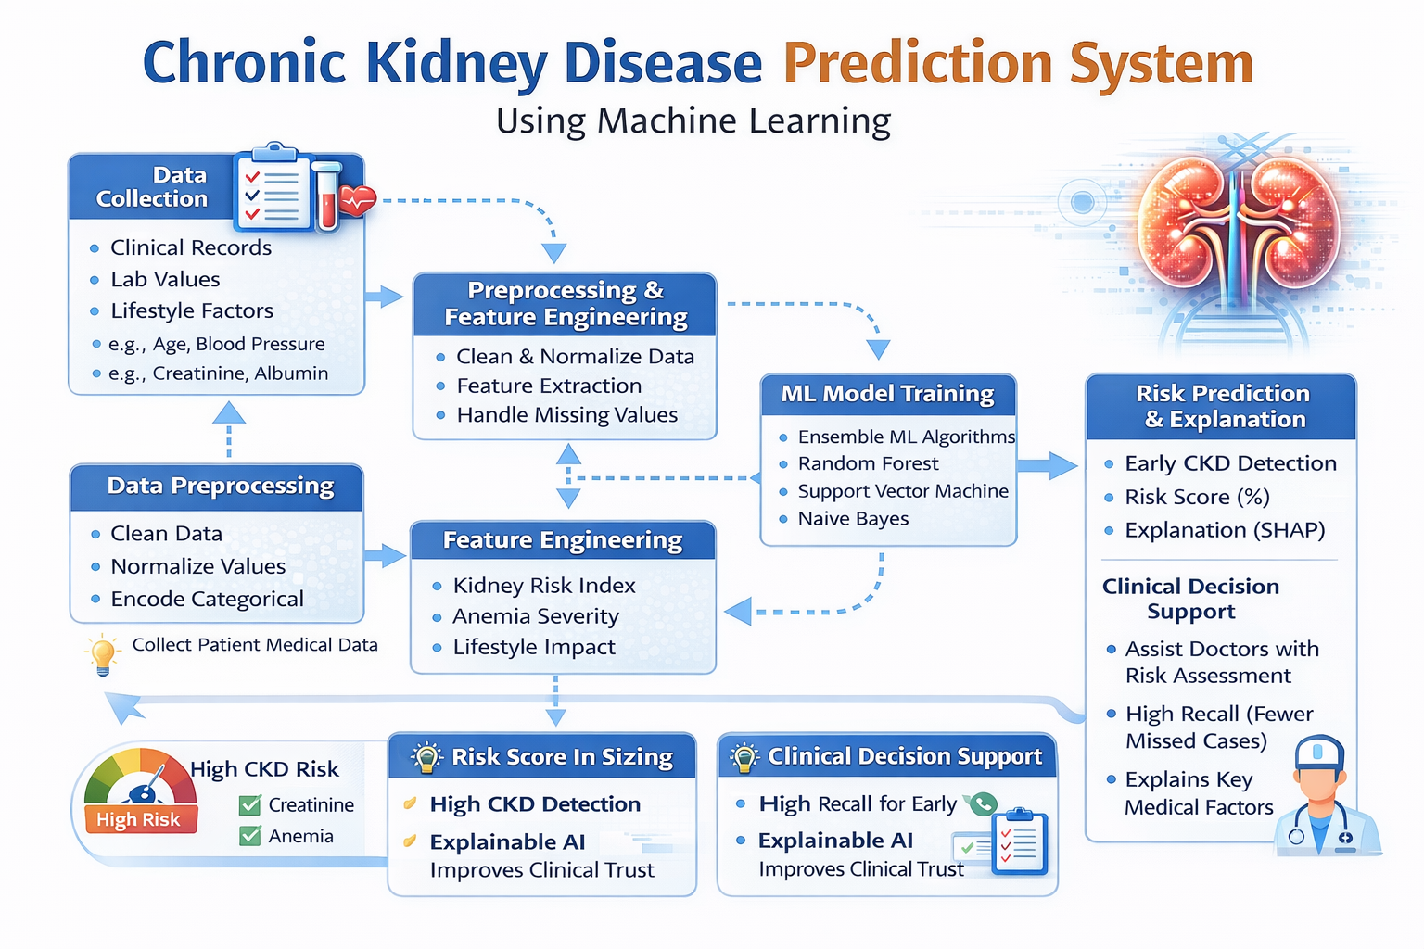
Project Flow

Slide 8
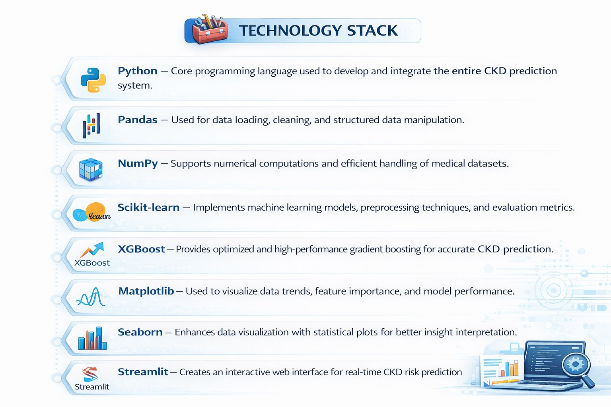

Slide 9
Result/Outcomes
1) Early Detection of CKD
The system enabled early identification of high-risk patients, even before severe symptoms appeared.
Early detection allows timely medical intervention and better disease management.
2) Clinical Decision Support
The system acts as a decision support tool for doctors by:
Assisting in OPD screening
Supporting referral decisions
Prioritizing high-risk patients
3) Reduced Diagnostic Burden
Automated analysis reduced the need for manual evaluation of multiple lab parameters.
Saved time for healthcare professionals in high-volume clinical settings.
4) Improved Patient Outcomes
Early warnings helped prevent disease progression to advanced stages.
Potential to reduce dialysis dependency and long-term healthcare costs.
Feature | Existing Solutions | Our Solution
Accuracy Level | ~90–95% (standard ML models) | Enhancements with ensemble + feature selection
Mobile / Web App Tool | Mostly not available | Interactive Mobile/Web UI with alerts & health advice
Progression Prediction (Future) | Mostly binary CKD yes/no | Predict CKD stage + risk progression within next 1-5 years

Slide 10
Future Perspective/Research
CKD Prediction ML Study: https://journalofbigdata.springeropen.com/articles/10.1186/s40537-022-00657-5?utm_source=chatgpt.com
ML-CKDP (Web App + Prediction Workflow):https://pmc.ncbi.nlm.nih.gov/articles/PMC10950726/?utm_source=chatgpt.com

Slide 11
Thank You

